Slide 1

OneSharedStory Database Design
By Matthew Edwards and Colin Warner

Slide 2
The Problem
One Shared Story connects families to their ancestry. Specifically, they help the African American community gain insight into their ancestry prior to emancipation. Our objectives are to:
Standardize the way volunteers transcribe data
Store transcribed data in a database
Create an interactive search tool

Slide 3
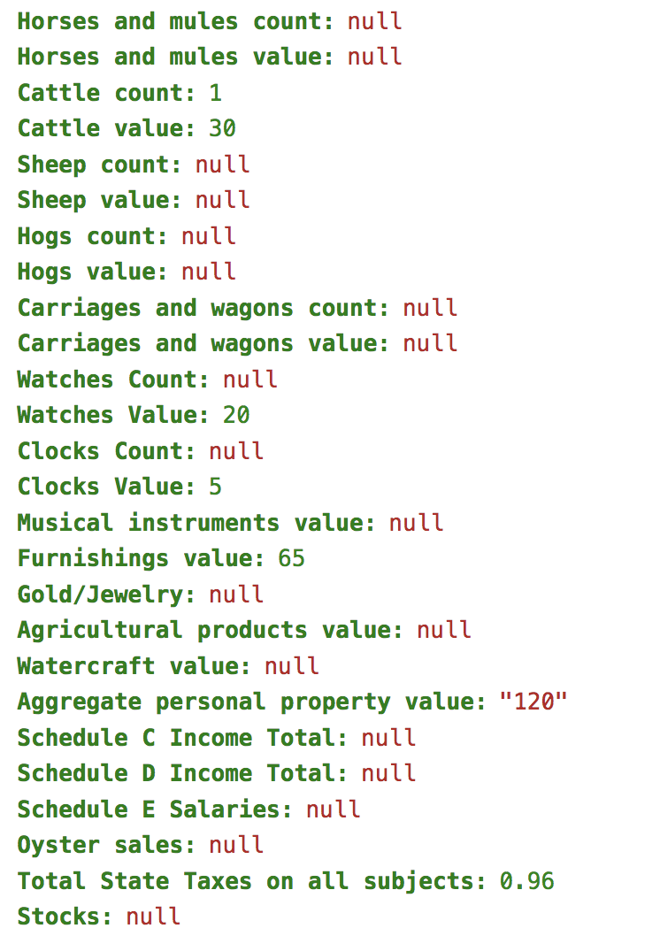
Data
Data source | Number of Records
Buckingham Property Tax 1867 | 3,216
Cumberland Property Tax 1867 | 1,795
Fluvanna Property Tax 1782 | 862
Fluvanna Property Tax 1867 | 2,272
Louisa County Birth Records 1853 | 4,851
Louisa Property Tax 1865 | 6,564
Louisa Property Tax 1866 | 1,308
Orange Property Tax 1867 | 1,308
TOTALS | 23,084

Slide 4
Database Architecture
First idea was relational database
Too tricky, moved on to NoSQL database
More Flexible
Output JSON files

Slide 5
Database Architecture
Structure
Current Data
Future Documents
SOURCE
1867 Tax Records
?
EVENTS
Person A pays taxes on ownership Person B
?
PEOPLE
Person A
Person B
?
ROLE
Landowner/Taxpayer
Enslaved taxable
?
Notes:
In order to create some sort of structure within our NoSQL database and to allow for efficient searching across collections, we’ve defined four columns to be consistent across collections. We use existing columns within each collection to define the source, event, people, and roles within each record.

Slide 6
Application Development
Flask API
Web application framework
Render from python script
Bootstrap
Establish navigation bar
Datatables
Quick sorting
Search across fields

Slide 7
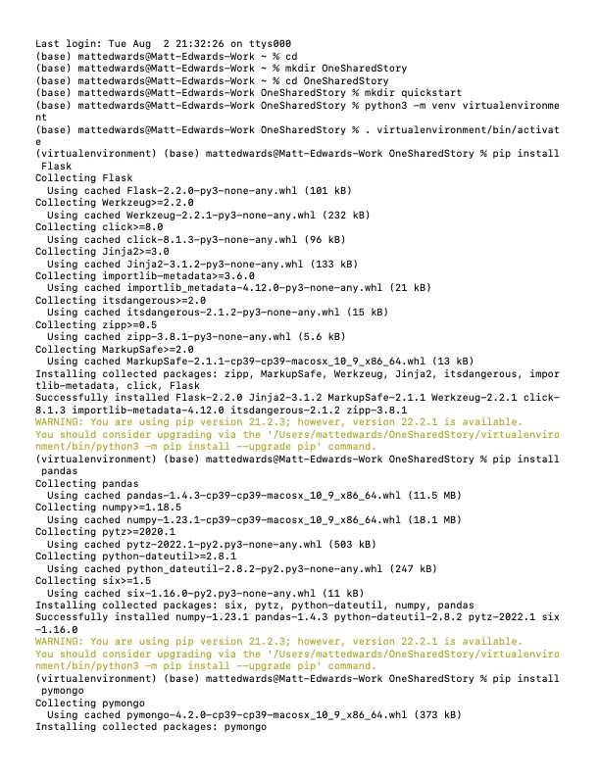
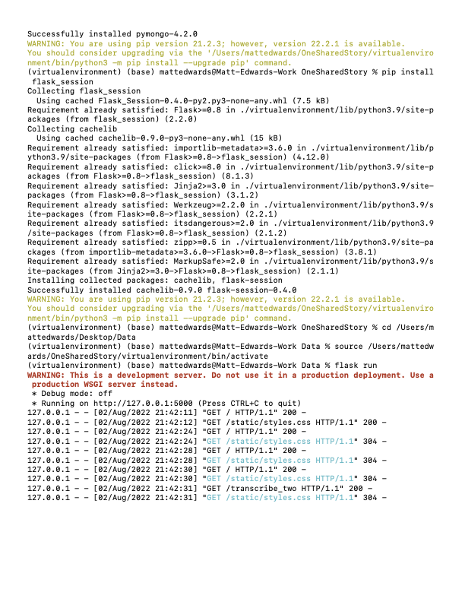
Build Hosting Tool

Slide 8
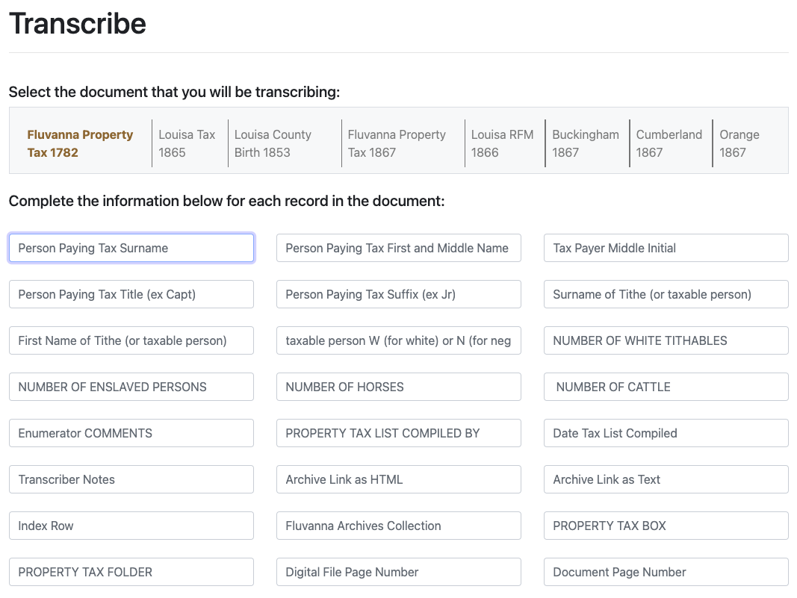
Transcribe Tool

Slide 9
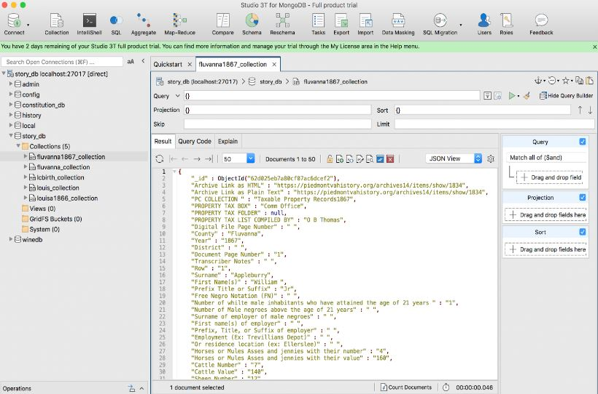
Studio 3T

Slide 10
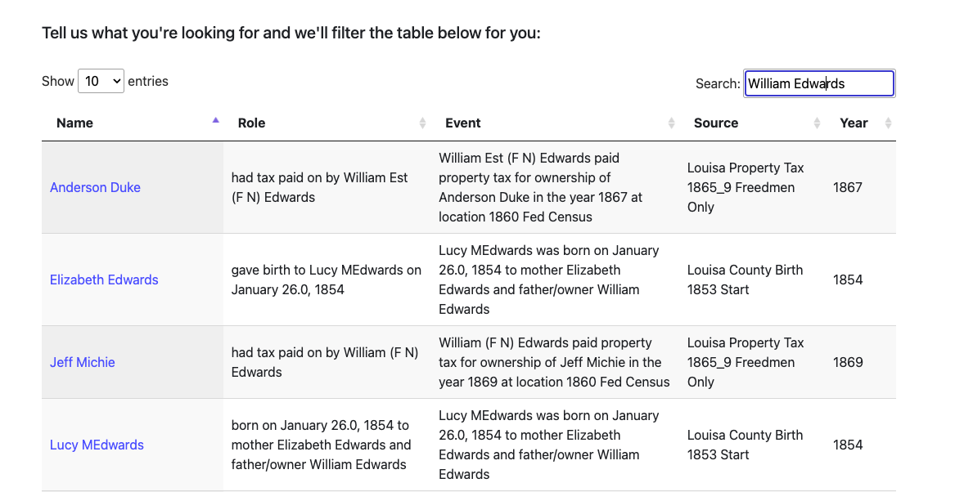
Search Tool

Slide 11
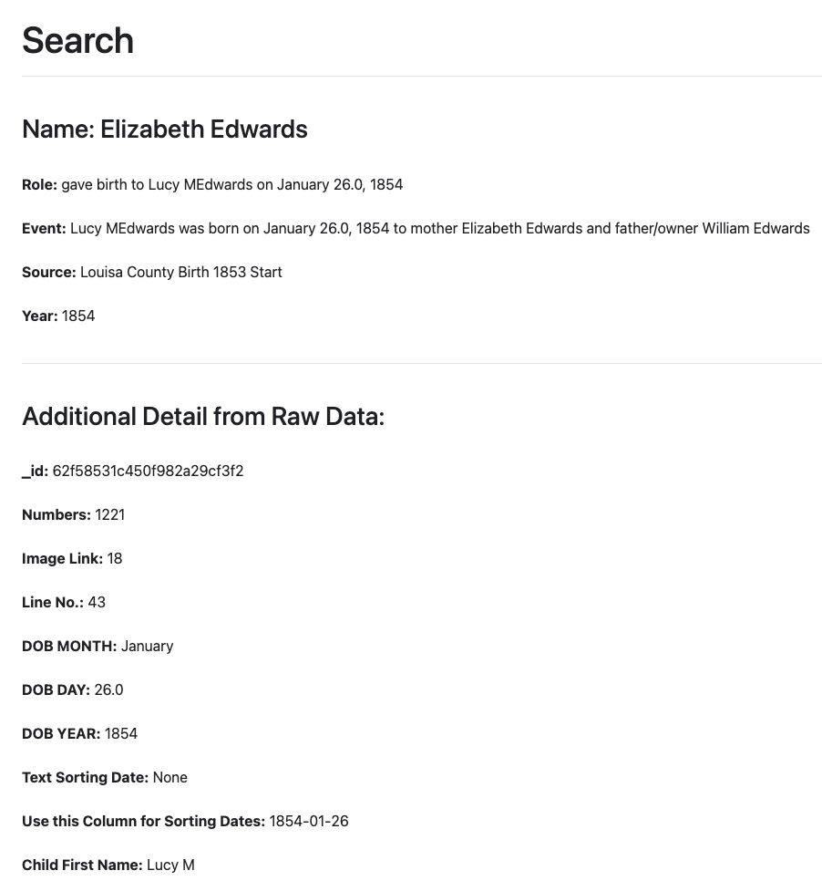
Surface raw record detail from search

Slide 12
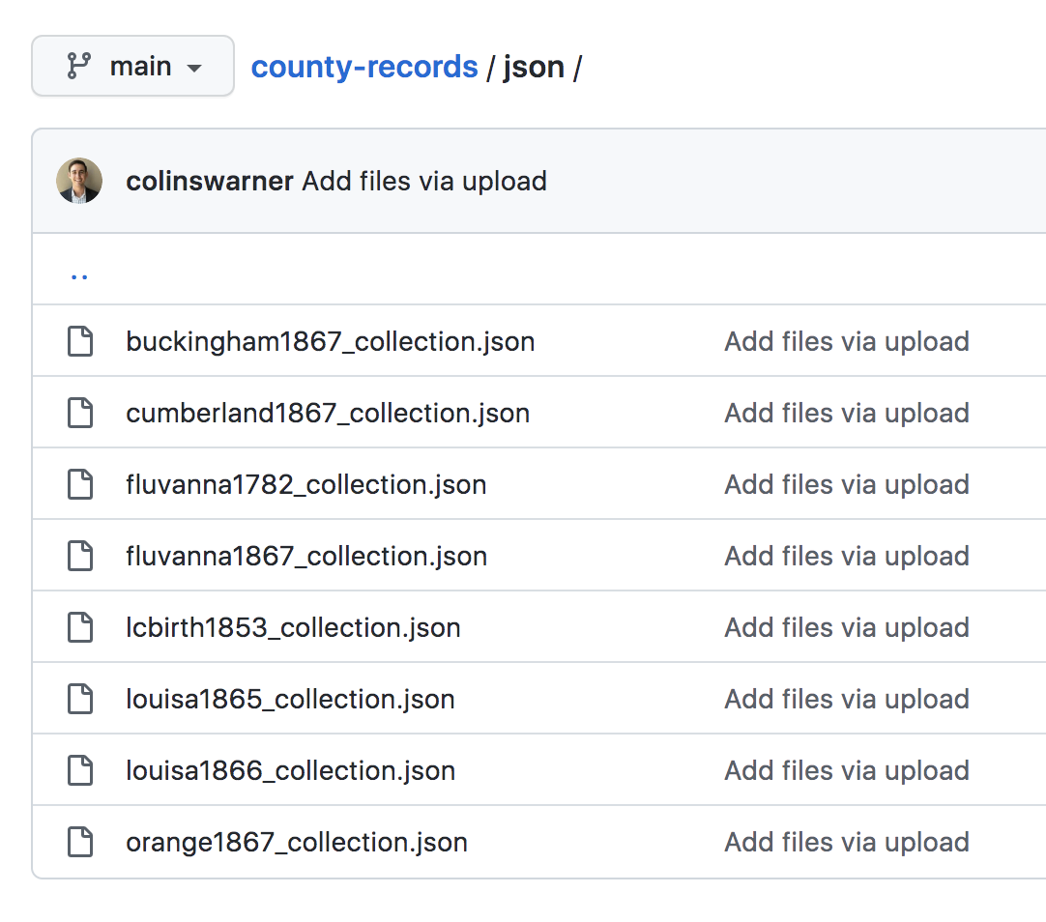
Value of JSON files to One Shared Story

Slide 13
Future Work
Build hosting framework through cloud website provider (i.e. Reclaim Cloud using Docker Container featuring Flask & MongoDB)
Tutorials provided for addition of future data sources
Expand search tool functionality (document links, maps, relationships)
Build universal transcribe tool

Slide 14
Questions?

